Slide 1
How to visualize your science
A mixed bag of thoughts and experiences
Rasmus Kristoffer Pedersen INM PhD-Day 2023

Slide 2
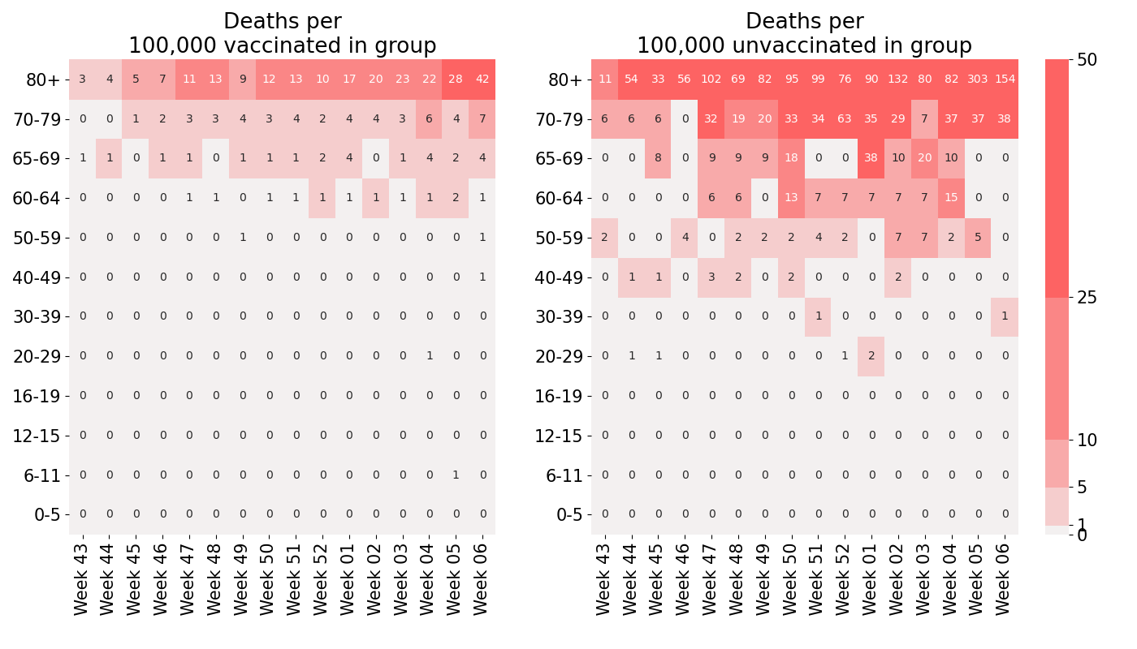
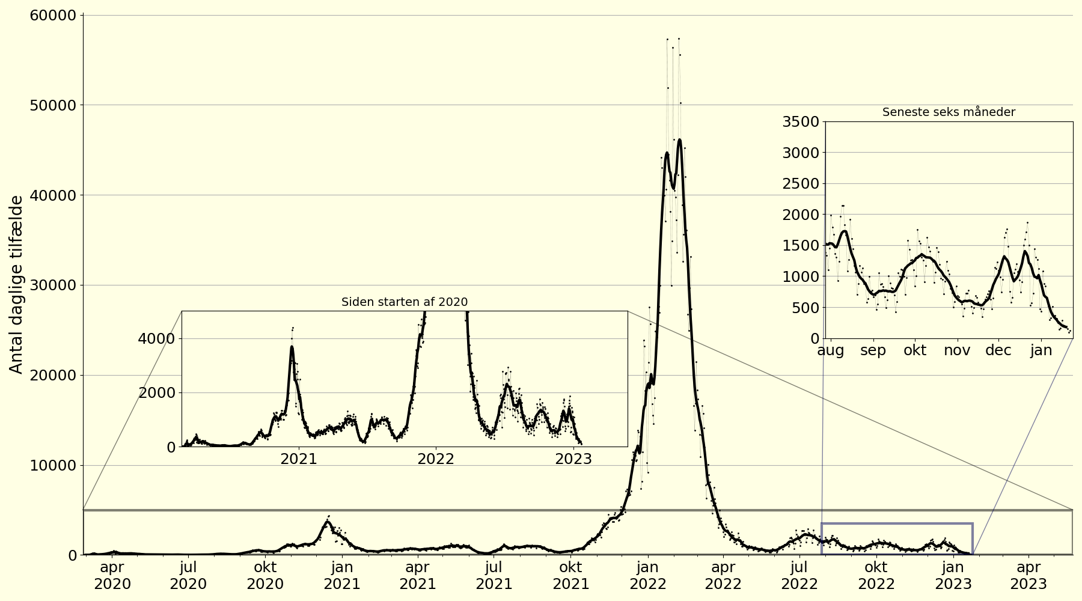
Who am I?
Mathematician BSc, MSc and PhD from RUC
Currently postdoc at the PandemiX center
Worked with analyzing and visualizing COVID-19 data during the pandemic
Not an artist or an expert in visual design
But very enthusiastic about science communication!

Slide 3
Why visualize?
or: Why you should care?
How people read articles
Read abstract
Skim article and look at pretty pictures
If still interested: Try to understand the rest
Memorable
Figure versus sentence
Effective way to pass on knowledge fast
Note: What to pass on is subjective!

Slide 4
General ideas
Think about your audience Use 2 seconds more
Data visualization can be difficult but can be made easier
Data visualization can be an art “Steal like an artist”
Visual communication is very subjective But “bad” and “good” still exists
The design-process can help you become familiar with the data

Slide 5
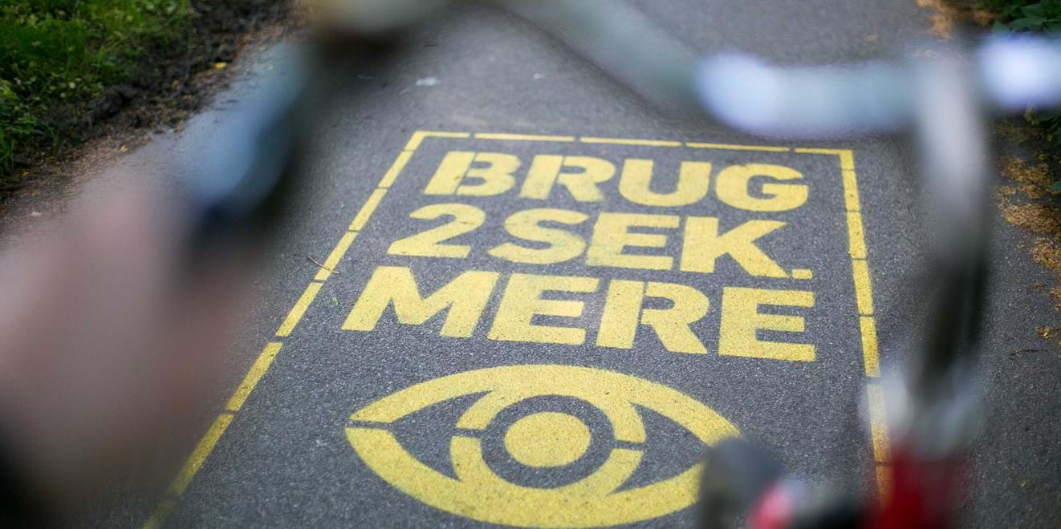

Slide 6
General ideas
Think about your audience Use 2 seconds more
Data visualization can be difficult but can be made easier
Data visualization can be an art “Steal like an artist”
Visual communication is very subjective But “bad” and “good” still exists
The design-process can help you become familiar with the data

Slide 7
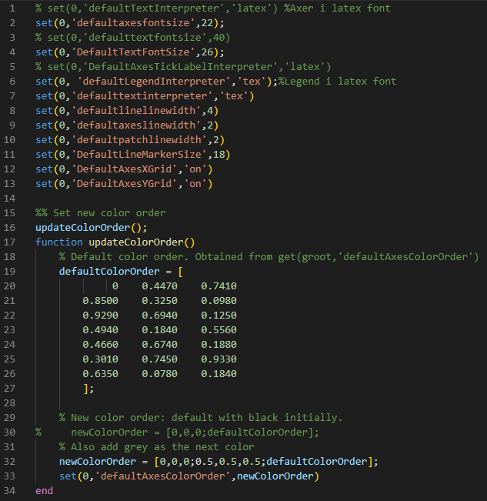
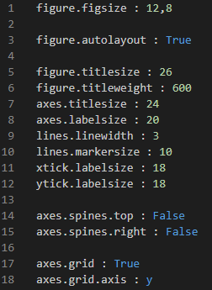

Slide 8
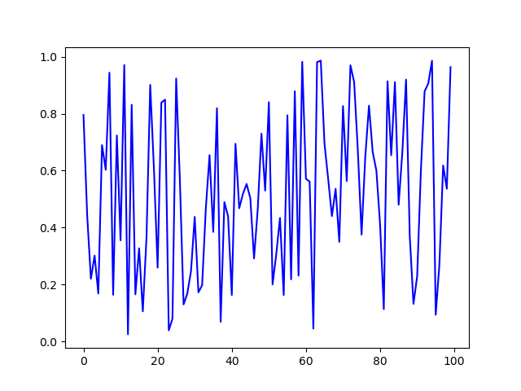
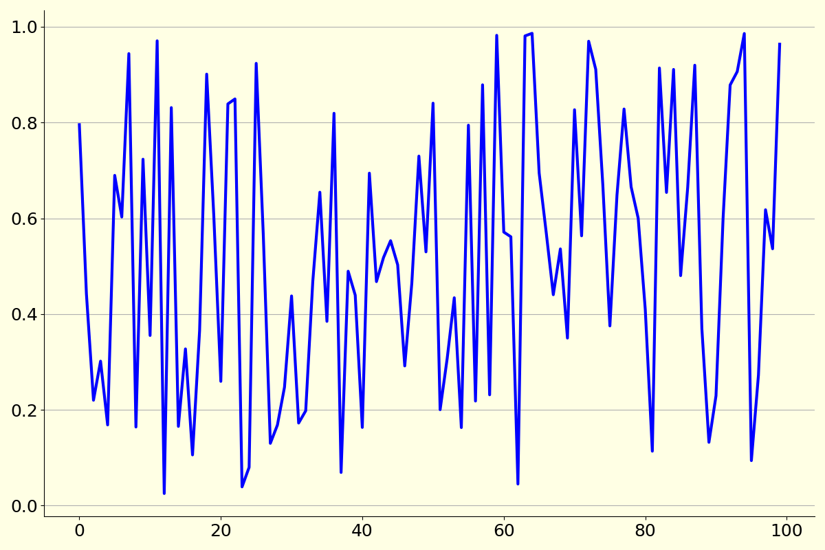

Slide 9
General ideas
Think about your audience Use 2 seconds more
Data visualization can be difficult but can be made easier
Data visualization can be an art “Steal like an artist”
Visual communication is very subjective But “bad” and “good” still exists
The design-process can help you become familiar with the data

Slide 10
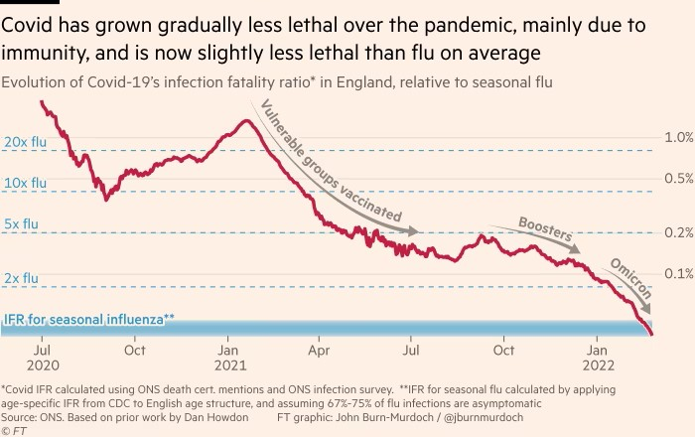
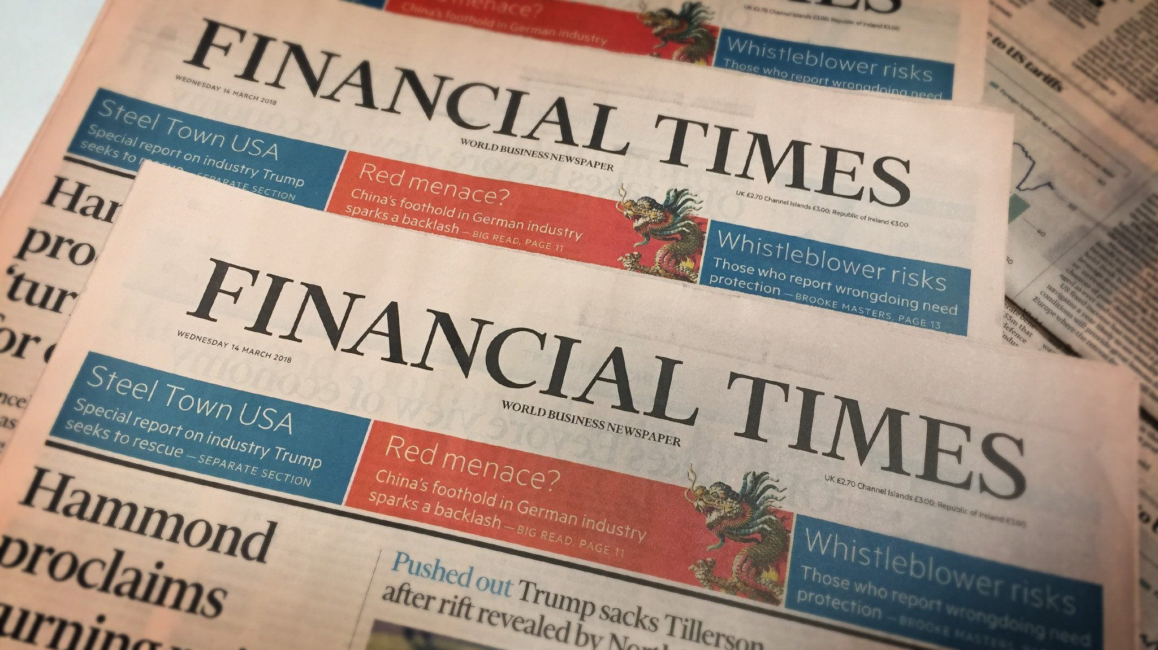

Slide 11
General ideas
Think about your audience Use 2 seconds more
Data visualization can be difficult but can be made easier
Data visualization can be an art “Steal like an artist”
Visual communication is very subjective But “bad” and “good” still exists
The design-process can help you become familiar with the data

Slide 12
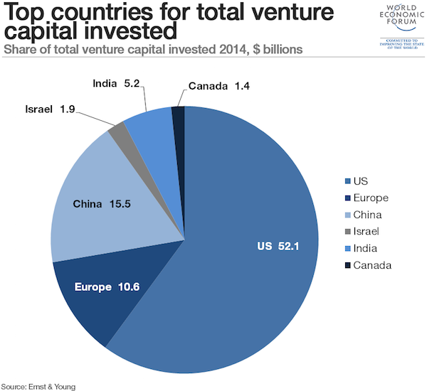
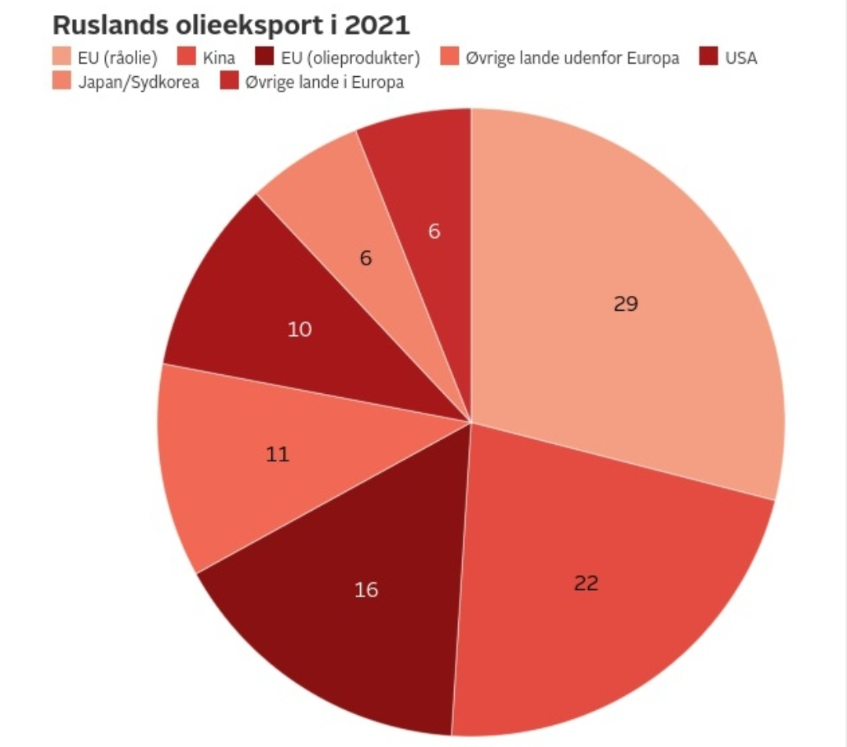

Slide 13
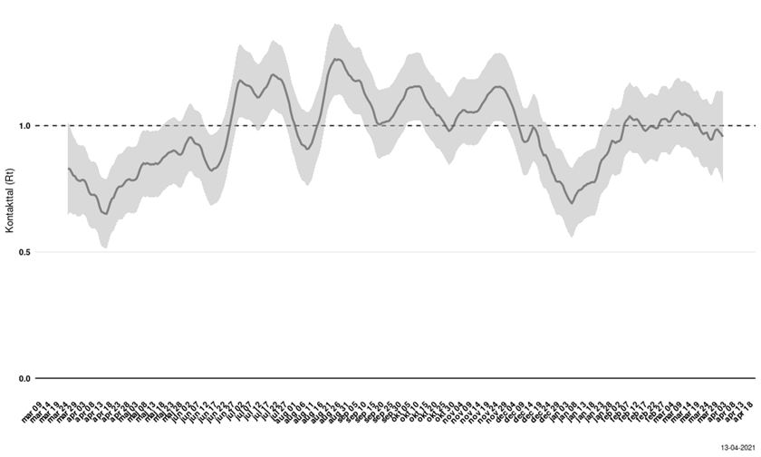

Slide 14
General ideas
Think about your audience Use 2 seconds more
Data visualization can be difficult but can be made easier
Data visualization can be an art “Steal like an artist”
Visual communication is very subjective But “bad” and “good” still exists
Visuals can be easier to understand

Slide 15
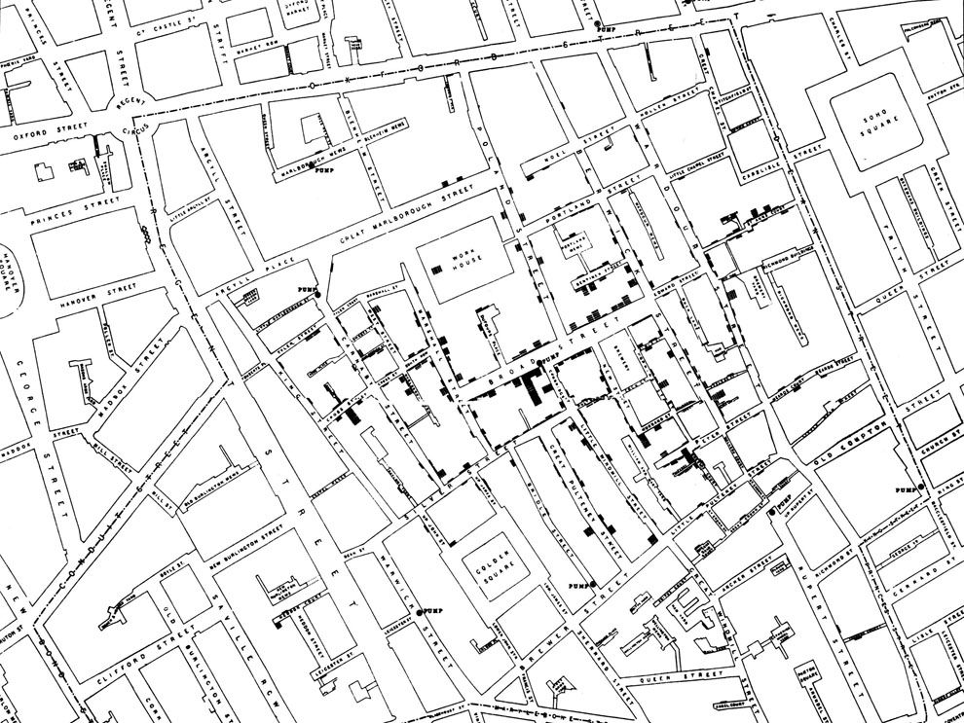
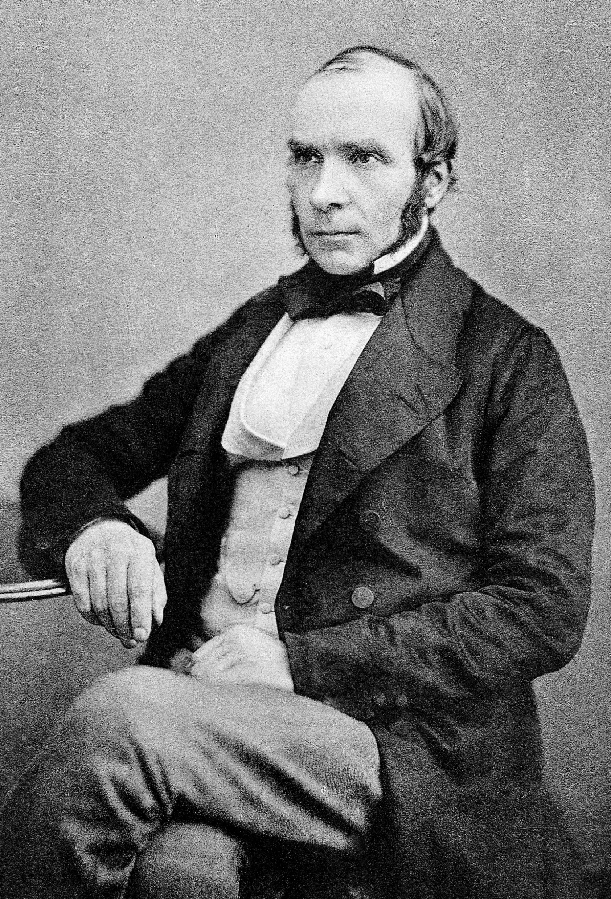

Slide 16
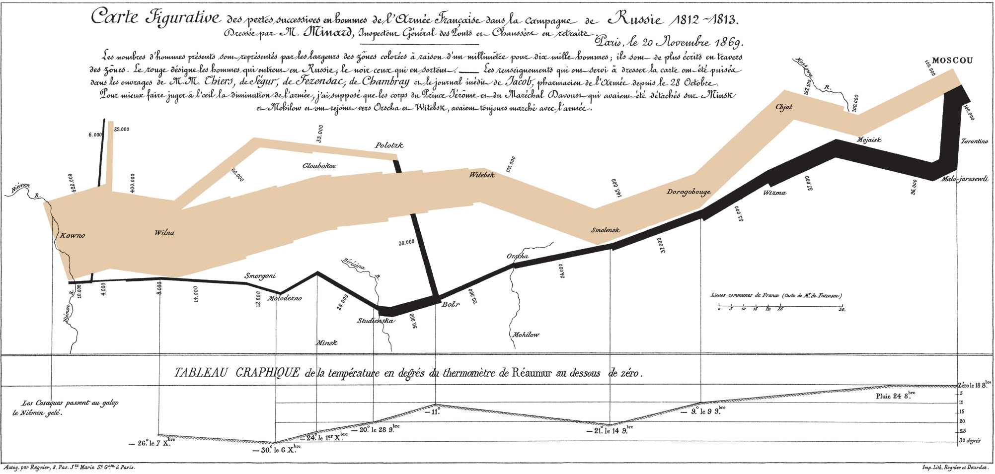

Slide 17
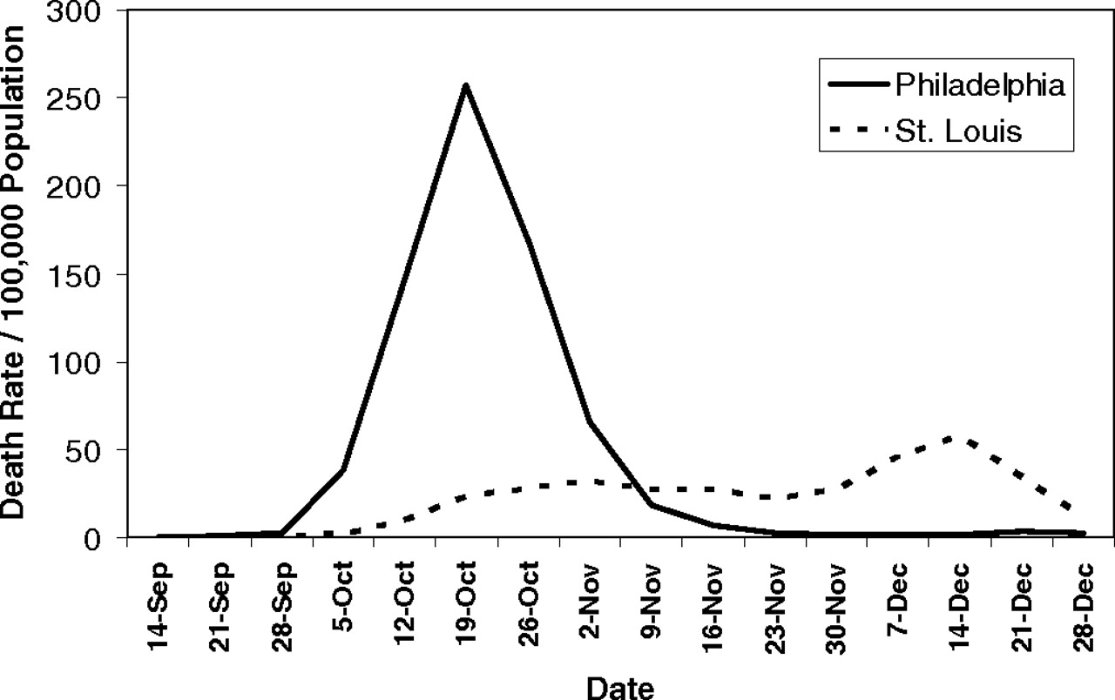
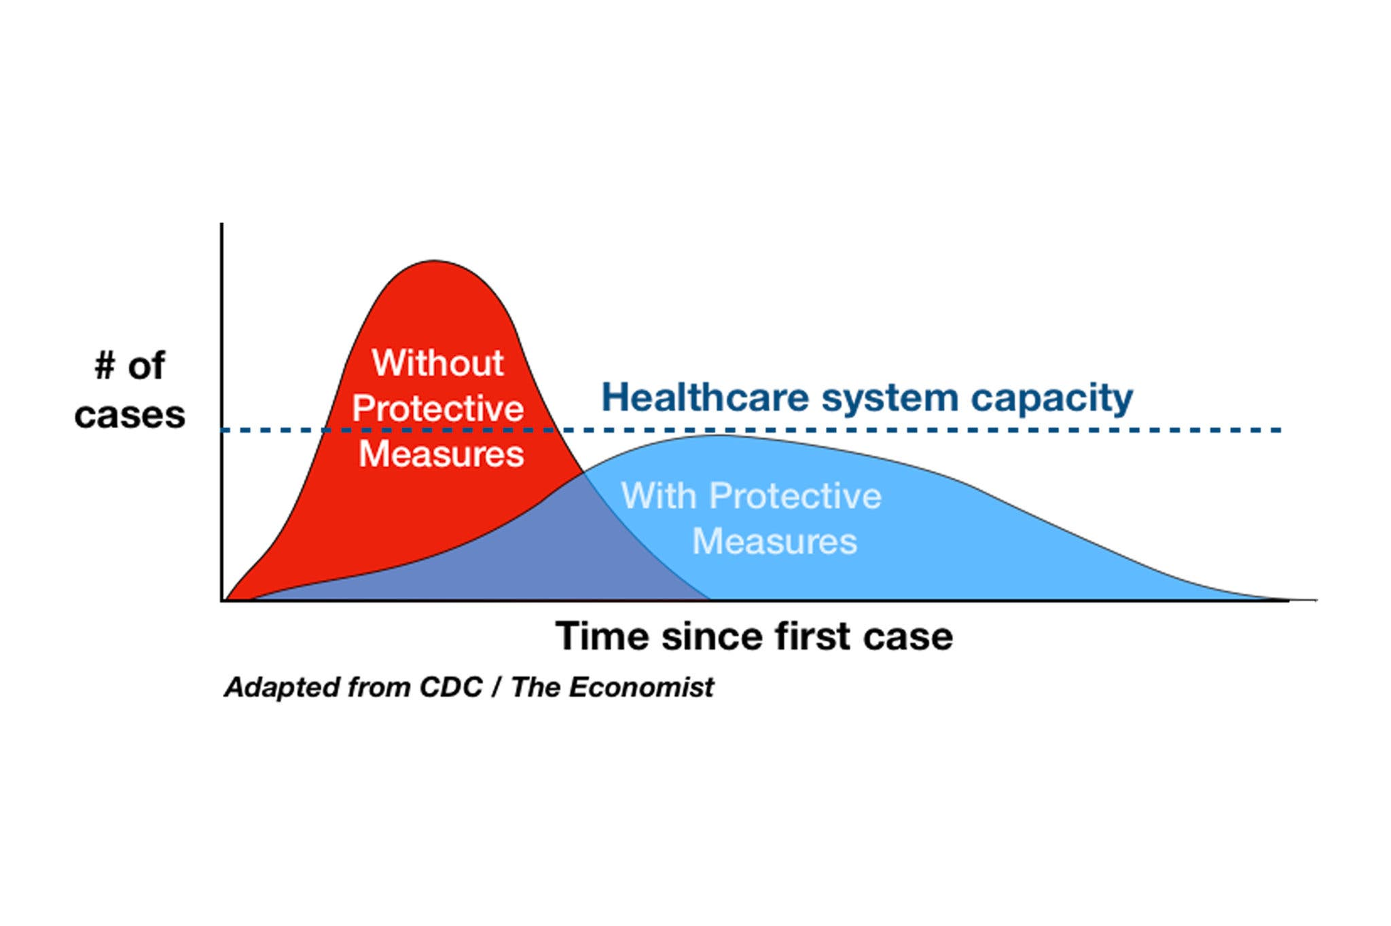
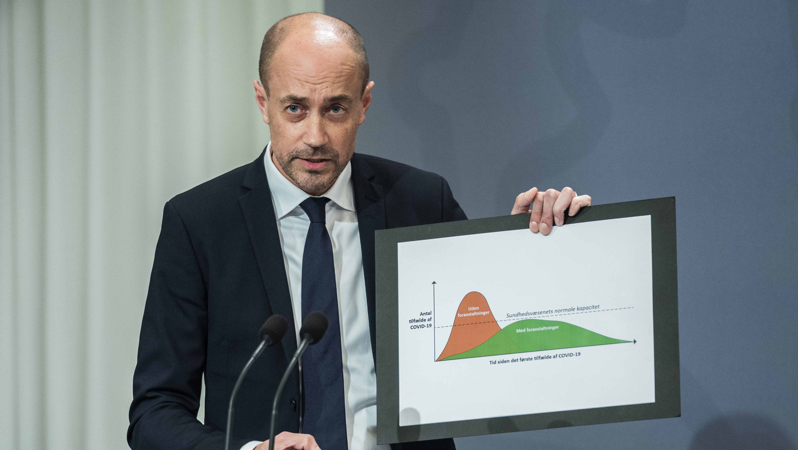
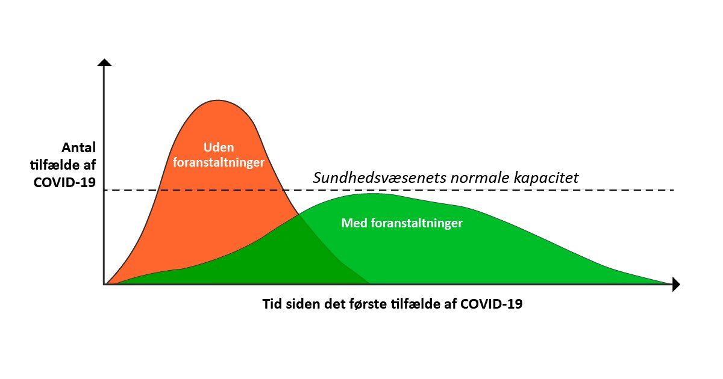
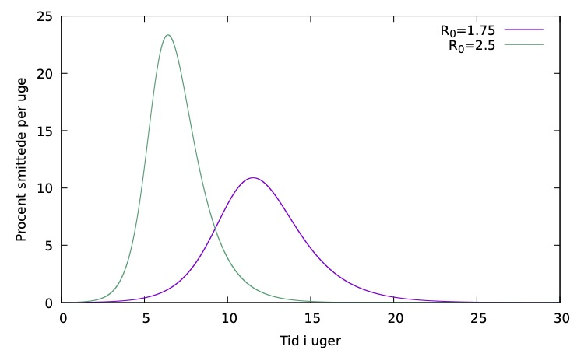

Slide 18
General ideas
Think about your audience Use 2 seconds more
Data visualization can be difficult but can be made easier
Data visualization can be an art “Steal like an artist”
Visual communication is very subjective But “bad” and “good” still exists
Visuals can be easier to understand

Slide 19
Thinking about visualization can also improve your research
Going through my own thought-process of improving a figure

Slide 20
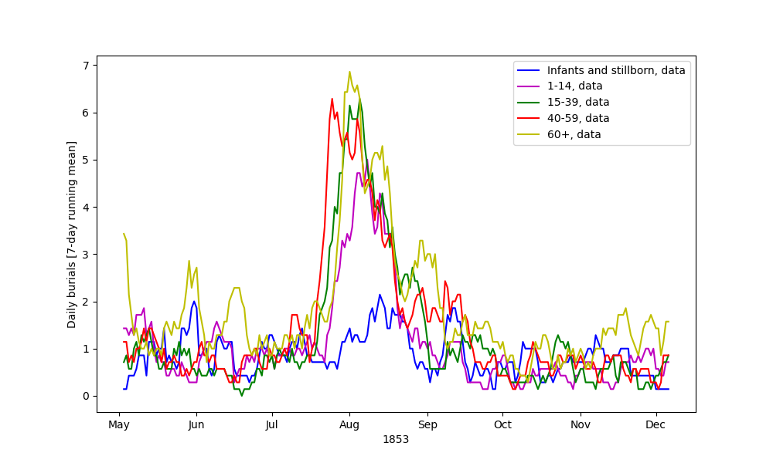

Slide 21
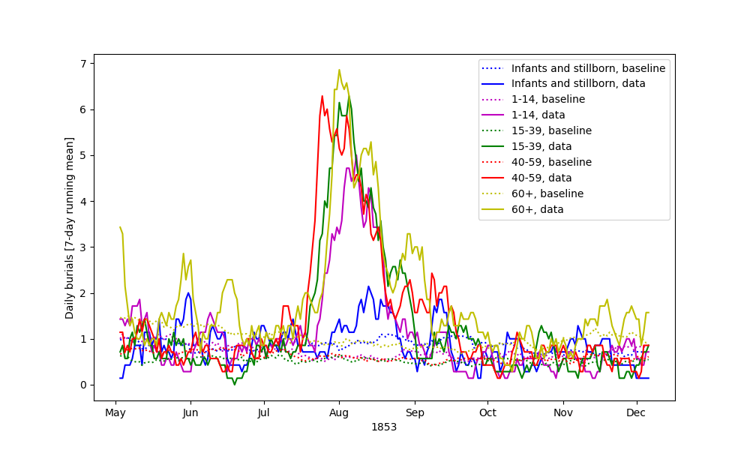

Slide 22
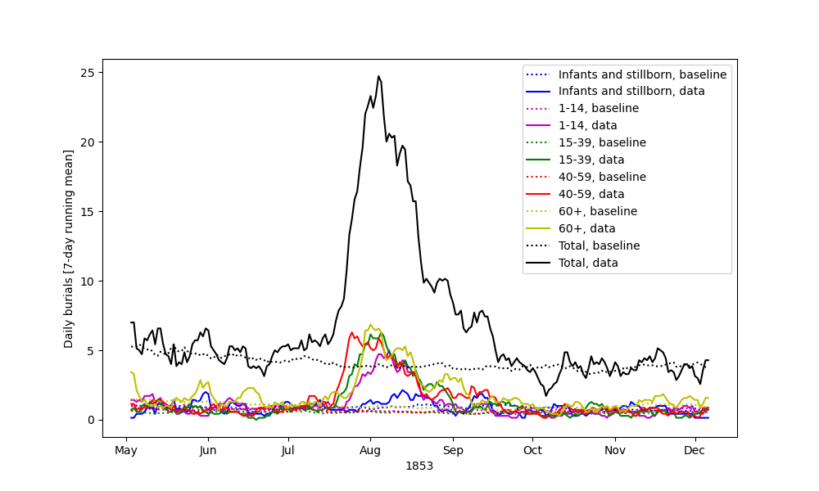

Slide 23
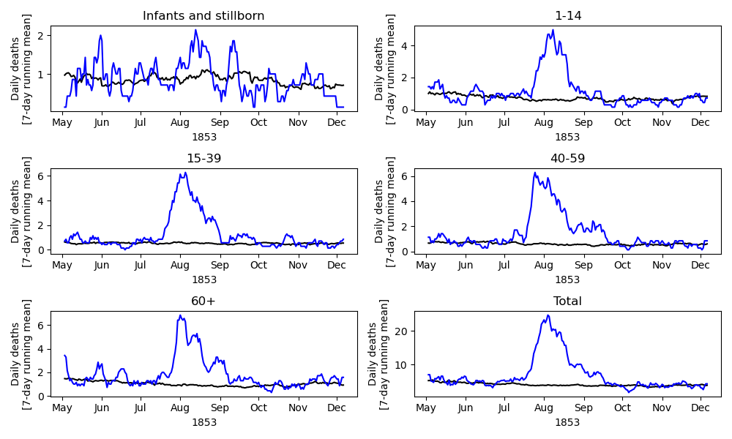

Slide 24
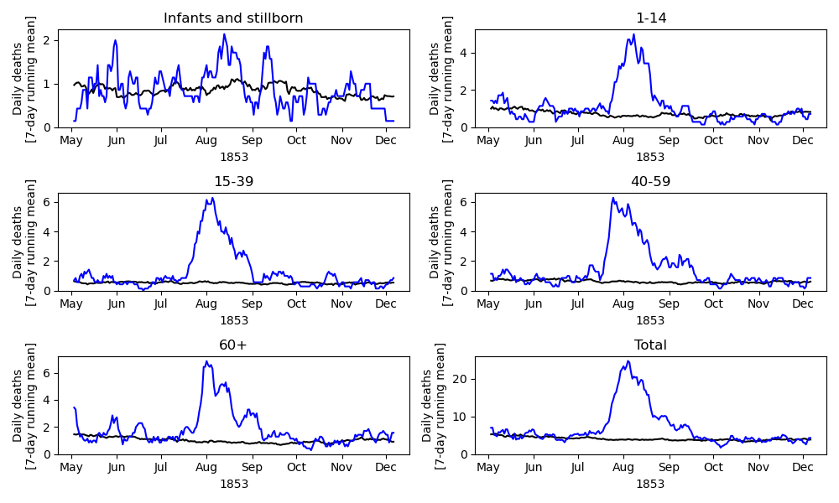

Slide 25
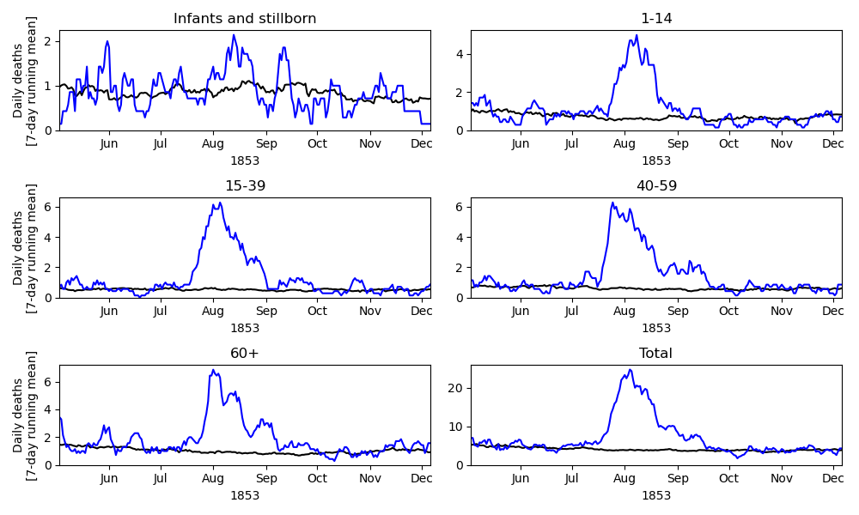

Slide 26
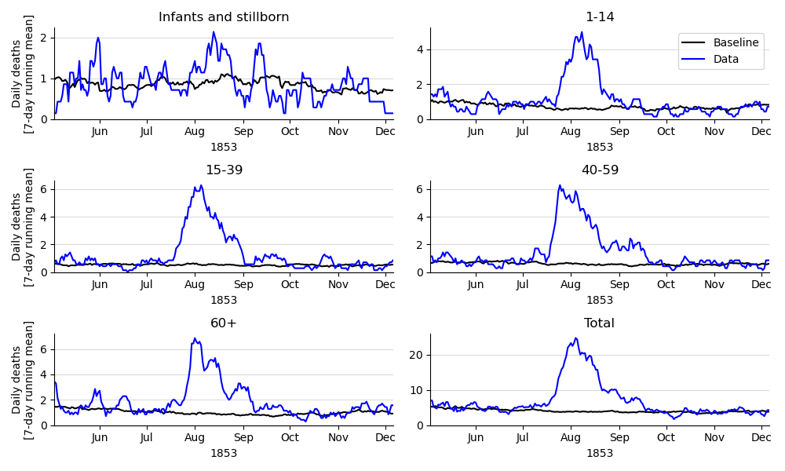

Slide 27
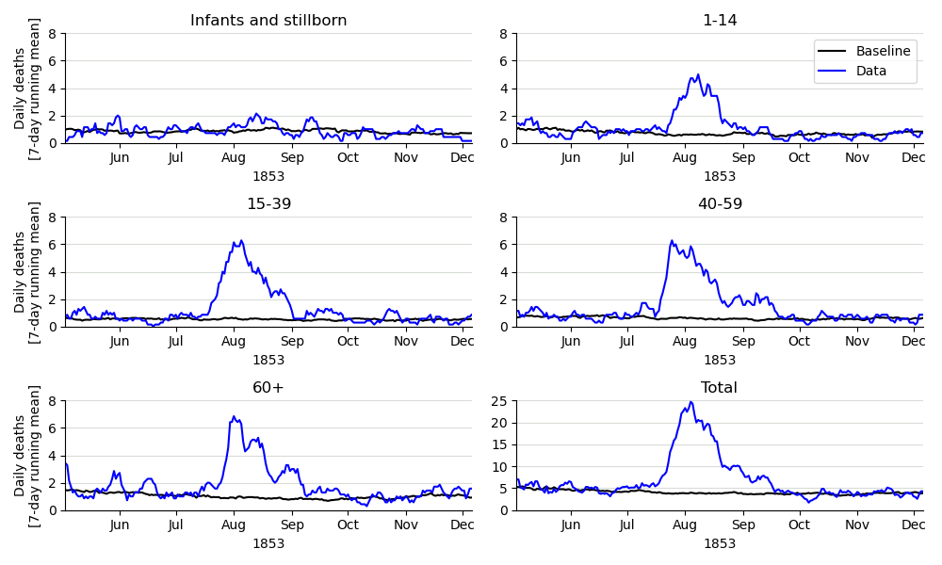

Slide 28
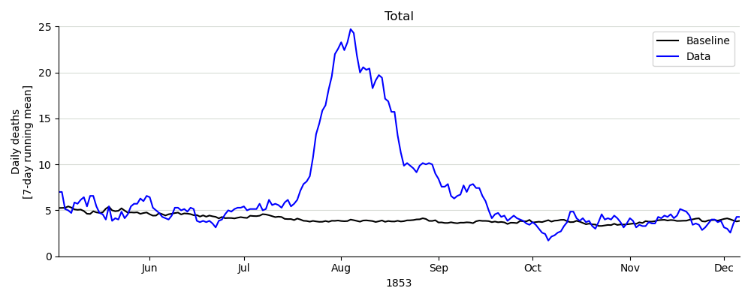
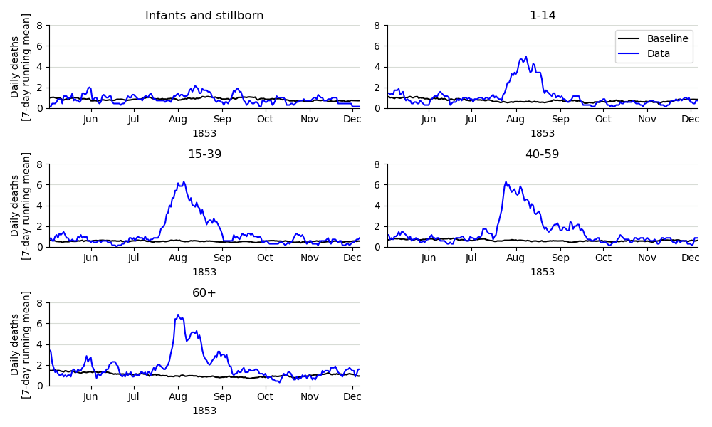

Slide 30
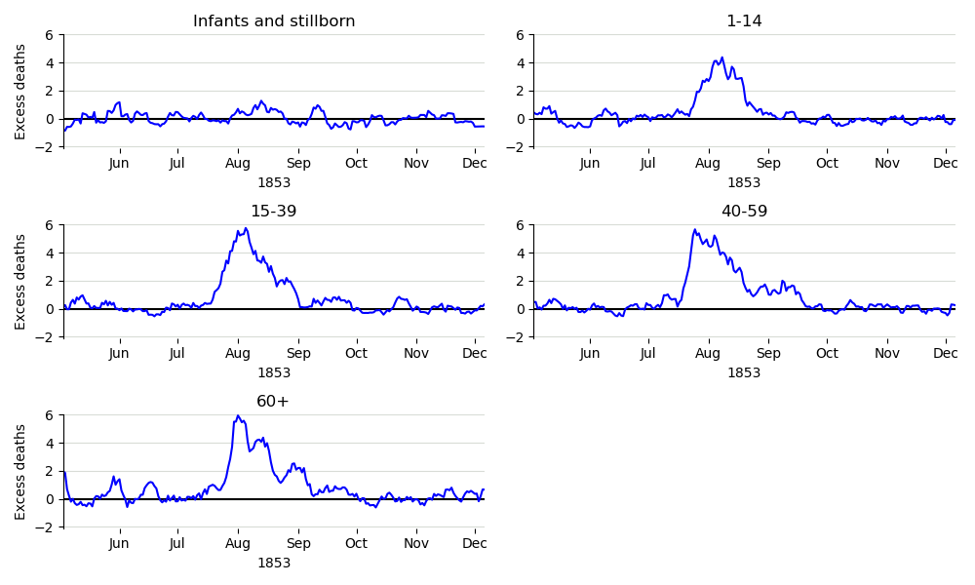

Slide 31
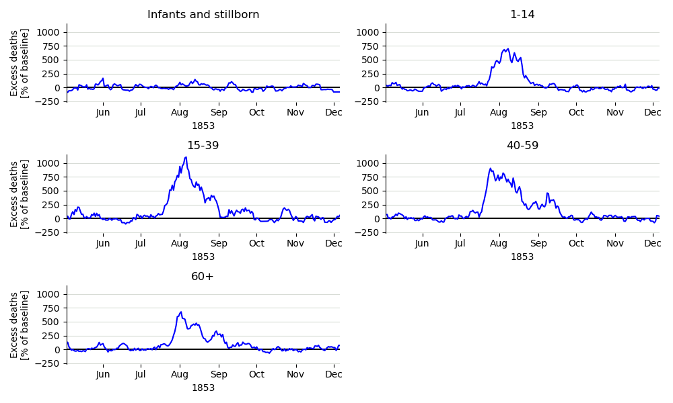
Perhaps this can be visualized differently?
How about a heatmap?

Slide 34
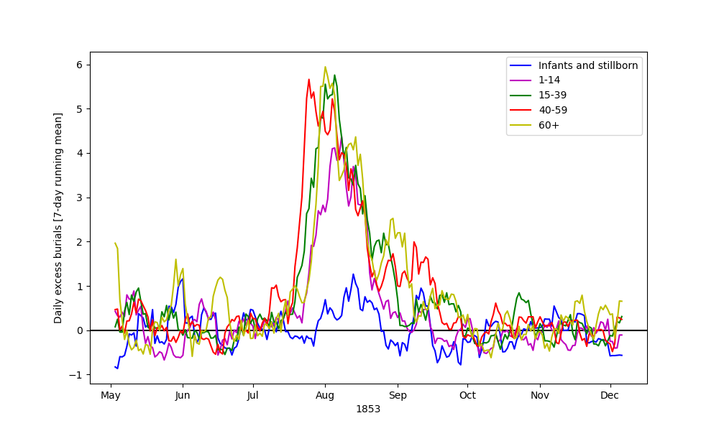

Slide 35
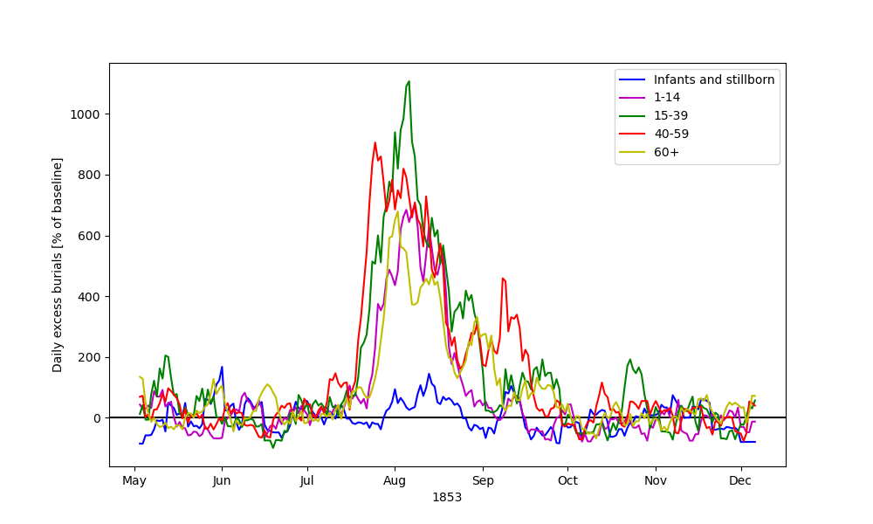

Slide 36
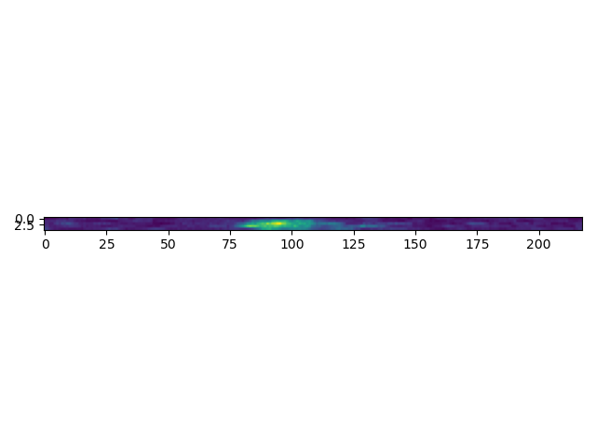

Slide 37
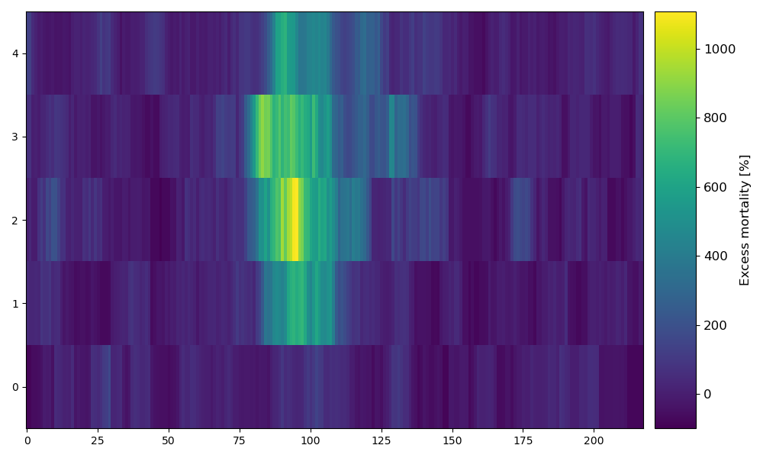

Slide 38
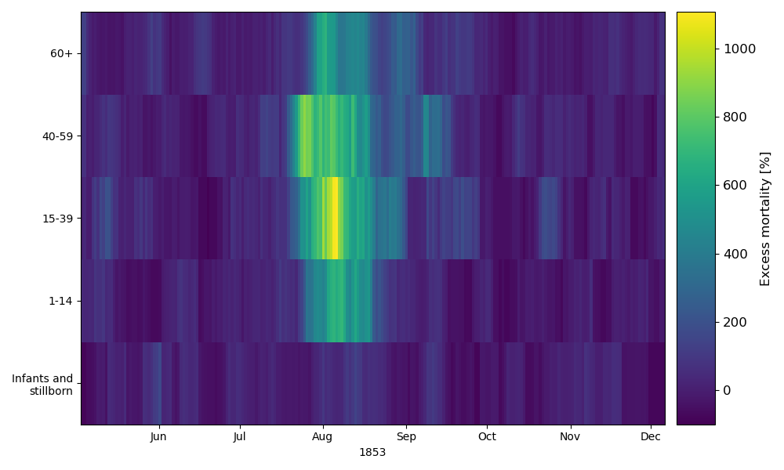

Slide 39
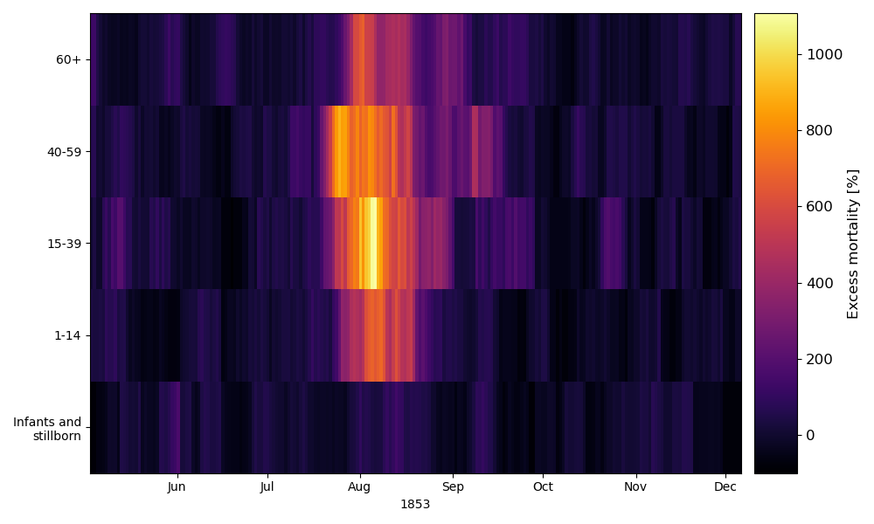

Slide 40
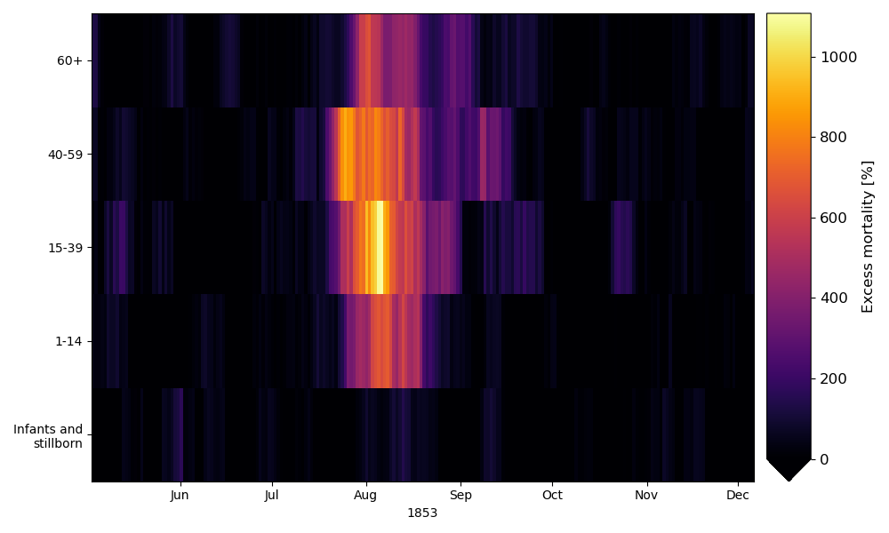

Slide 41
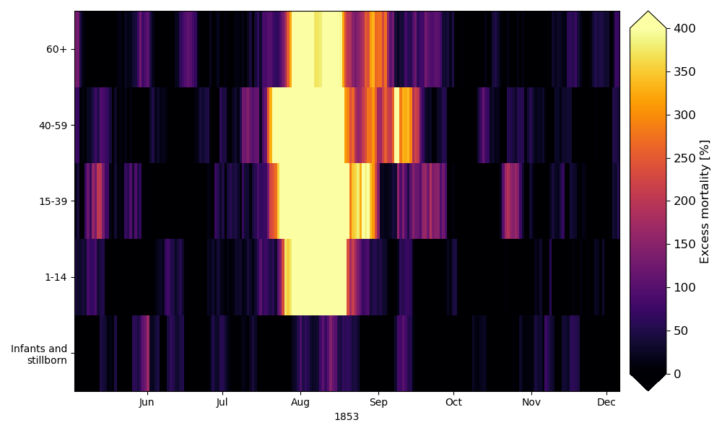

Slide 42
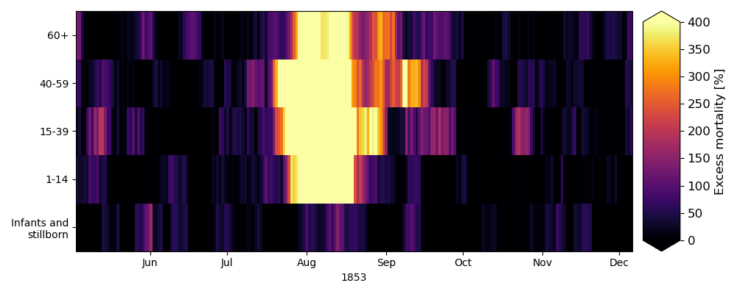

Slide 43
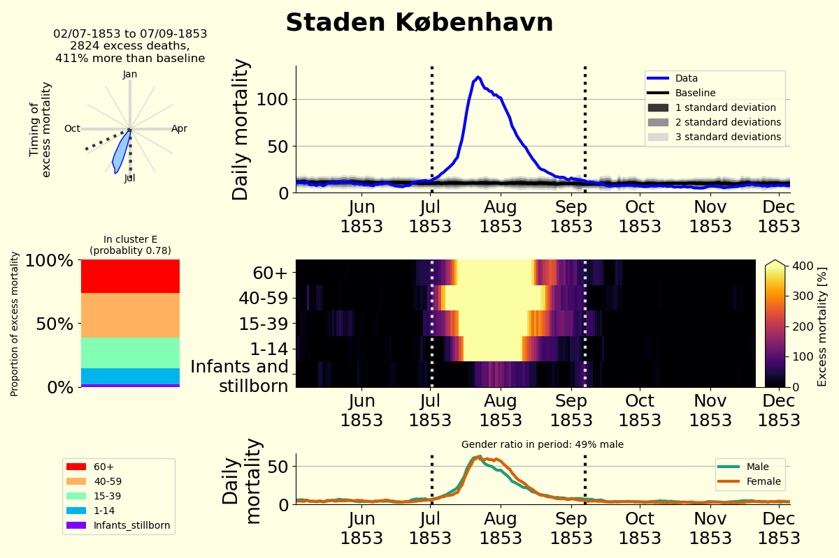

Slide 44
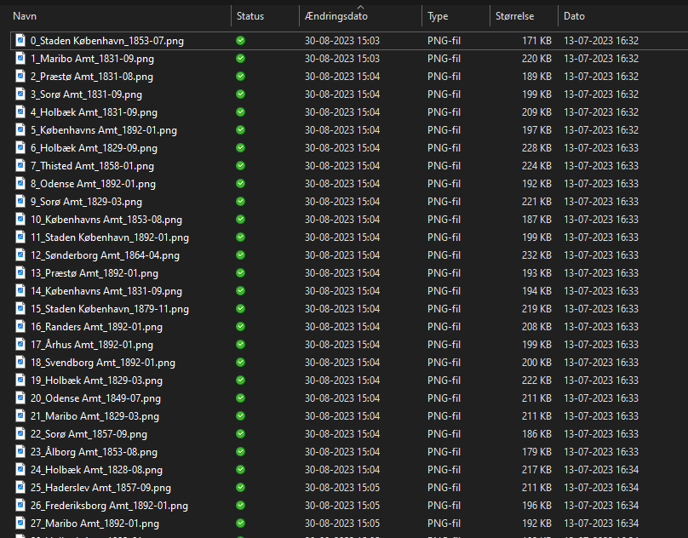

Slide 45
Summing up

Slide 46
Summing up – Why spend time visualizing data?
Good visual communication can be a strong tool You already have the insight, your reader does not, so help them
Use 2 seconds more Your audience will appreciate it!
Getting experience with visualization now, makes it easier for you in the future Find ways to make your work easier

Slide 47
Summing up – Why spend time visualizing?
It can help you understand your work better
You have a deep understanding, the reader doesn’t Help them understand the specific things you’ve learned yourself
Getting experience with visualization now, makes it easier for you in the future Find ways to make your work easier

Slide 48
You need a nice front-page for your thesis anyways!
And last, but not least: Why spend time making beautiful visualizations?

